Slide 1
FCC’s National Broadband Plan
What is the role of the States?
Will the plan provide incentives to invest in a broadband capable network?
Bob DeBroux
Director – Federal Affairs and Public Policy
TDS Telecom

Slide 2
TDS Washington Operations

Slide 3
TDS Washington Operations
Asotin Telephone Company
Lewis River Telephone Company
McDaniel Telephone Company
96% broadband availability
11,000 access lines
767 square miles
14 lines per sq. mi.
Notes:
La Center
99% of households can get DSL
77% of households that can get DSL can get a max of 10Mb down, 768k up
24% of households that can get DSL can get a max of 3Mb down, 512k up
Salkum
91% of households can get DSL
79% of households that can get DSL can get a max of 10Mb down, 768k up
21% of households that can get DSL can get a max of 3Mb down, 512k up
Asotin
97% of households can get DSL
74% of households that can get DSL can get a max of 10Mb down , 768k up
26% of households that can get DSL can get a max of 3Mb down, 512k up
*Stats represent households connected to DSL equipment. It does not state exactly how many customers will qualify for DSL. Some customers may not qualify due to the limitations of the DSL technology, such as distance from the DSL serving equipment.

Slide 4
States’ Role
Closing the broadband availability gap requires financial support from federal, state and local governments (138)

Slide 5
States’ Role
Closing the broadband availability gap and connecting the nation will require a substantial commitment by states and the federal government alike. This commitment should must include initial support to cover the capital costs of building new networks in areas that are unserved today, as well as ongoing support for the operation of newly built networks in areas where revenues will be insufficient to cover ongoing costs. (139)

Slide 6
States’ Role
Reform requires federal and state coordination. The FCC should seek input from state commissions on how to harmonize federal and state efforts to promote broadband availability. (143)

Slide 7
States’ Role
In targeting funding to the areas where there is no private sector business case to offer broadband service, the FCC should consider the role of state high-cost funds in supporting universal service and other Tribal, state, regional and local initiatives to support broadband. A number of states have established state-level programs through their respective public utility commissions to subsidize broadband connections, while other states have implemented other forms of grants and loans to support broadband investment. (145)

Slide 9
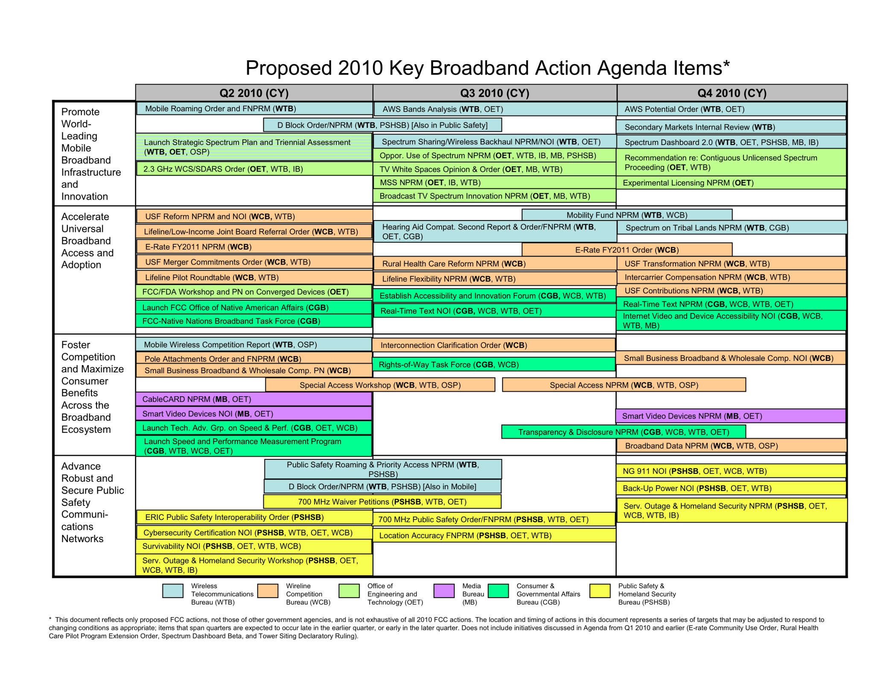

Slide 10
Questions – Stage 1
What are the impacts of eliminating IAS and freezing ICLS on a per line bases?
What is the impact of moving Rate of Return Carriers to incentive regulation?
What is the impact of the long term intercarrier compensation reform framework?
What are the interim measures to curb arbitrage, and what are their impacts?

Slide 11
Questions – Stage 2
How does the transition to the CAF work?
How are legacy funds transitioned into broadband funds?
What is the impact of choosing between a fixed and a mobile provider of broadband in high cost areas?
How is the funding determined where there is no “bidding?”
How will lost revenues from access rate reductions be dealt with, if at all?
SLCs? Local rate increases? Not at all?

Slide 12
Questions – Stage 3
How does the CAF work?
Does it provide adequate incentive for deployment of broadband networks?
Is “reasonable comparability” attained and maintained?
Does the plan have the potential to produce “unfunded mandates”
Will there be areas where no one can afford to serve?

