Slide 2
Welcome and Introductions

Slide 4
Purpose of Workshop to:
Discuss technical issues related to staff recommendation,
Highlight areas of agreement and disagreement,
Allow discussion of alternative approaches or concepts.

Slide 5
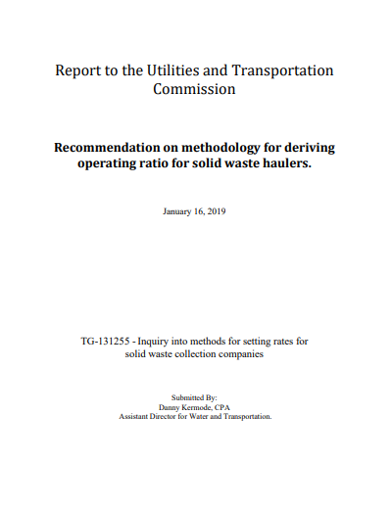
Review of Staff Recommendation
Computes return on investment before income taxes and interest,
7 year data set,
Recognizes leverage risk,
Updated financial data from comparable companies,
Recommends updating data at least every three years but no more than five years.

Slide 6
Presentation by WRRA
Cleve Tyler & Paul Diver

Slide 8
Discussion of Model Attributes Matrix

Slide 9
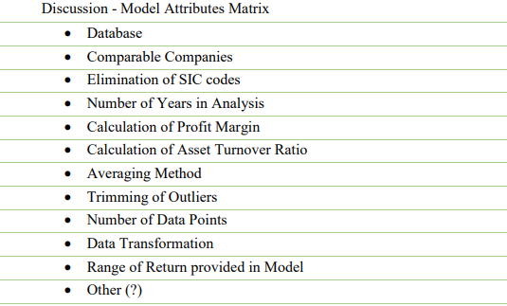

Slide 15
Others?

Slide 16
Next Steps in Process
Written Comments

Slide 17
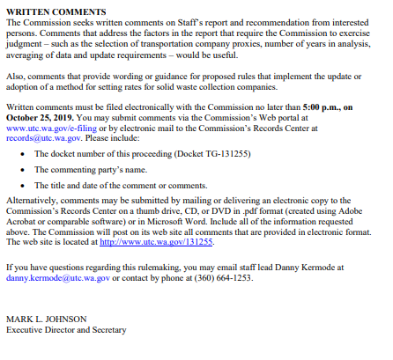
Next Steps in Process

Slide 18
Next Steps in Process
CR-101 with draft rules

Slide 19
Next Steps in Process
Comments to Draft Rules

Slide 20
Next Steps in Process
Workshop with Commission

Slide 21
Next Steps in Process
CR 102 with Proposed Rules

Slide 22
Next Steps in Process
Final Comments

Slide 23
Next Steps in Process
Adoption of Rules by Commission Order

Slide 24
General Comments or
Final Words for the Record.

Slide 25
THANK YOU for all your time and feedback!

